Slide 1
Ptool Development Team Stand-up
October 31, 2019
Facilitated by: Ross Speir and Kyle Maddox
Human Factors Engineering (HFE)
Office of Health Informatics (OHI) (10P2)
Veterans Health Administration (VHA)

Slide 2
Agenda
Updates
Team Recruitment
Discovery Data Work
My HealtheVet Patient Generated Data Portal
Project Management
BHIP pilot at VISN 9
Rapid Prototyping Team F2F Meeting
Preparation: Prioritizing User Needs / Design Objectives
Questions / Discussion

Slide 3
Updates: Team Recruitment
Core Team
Project Manager
MH Informaticist – for analytics, data warehouse and SharePoint dashboard design expertise
CAC – for CPRS/VISTA and Reminder Dialog expertise
Extended Team
Interaction Designer
Clinical Decision Support SME
Systems Reengineering SME
Next Steps
Elliott
CAC at TVHS?

Slide 4
Project Timeline (Notional)
Rapid Prototyping (Nashville)
Prototype Eval (Palo Alto)
Prototype Eval (Houston)
Prototype Eval
(Boston)
MVP defined
Pilot Testing
(TVHS, Palo Alto,?)
Oct
Nov
Dec
Jan
Feb
Mar

Slide 5
Project Management
Introductions
Business owner needs
Next Steps
Provide the WBS to team
Schedule Palo Alto

Slide 6
Updates: Discovery Phase Data Work
HFE met twice with Dr. Bradshaw (TVHS) to review and organize user experience data discovered during TVHS site visit.
Bottom Line Up Front
Identified ‘User Stories’ and Design Objectives which will serve as requirements.
Exercise to prioritize discovered data for rapid prototyping.
Identified contextual use case information.
Patient scenarios and personas for evaluation purposes.
Overview of TVHS MH Provider tasks
Next Steps
AirTable is not a long-term solution
Export to Excel and share
Verify GitHub is available inside the network. Set up for PT project versioning and project management

Slide 7
Updates: Collecting MH Patient Data/Quick Measures
HFE is engaged with Connected Care and the My HealtheVet team.
Bottom Line Up Front
The My HealtheVet Patient-Generated Data (PGD) work group is interested in expanding their PGD availability to other avenues and feel that Ptool makes an interesting use case.
They would like to meet to introduce our project work and theirs and discuss timelines.
Attendance and best availability?
Next Steps
Schedule meeting
Ensure Mandi and Elliot participate

Slide 8
Line of site to MVP definition
Objective: Produce a minimally viable product intended for implementation at legacy sites.
Core Team
Business Office
VAMC Pilot Sites
Technical SMEs
MVP Deliverables
Working prototypes developed and assessed by end users at pilot sites
Intended outcomes / value measures
Draft Evaluation and Implementation plans
Backlog of unmet user and stakeholder needs

Slide 9
VISN 9 Engagement
Next Steps
Do we need to get access to Cerner MH/psychotherapy workflow?
This should not impact initial product design.
Get a demo of Cerner MH module (low priority)
Cannot be designed exclusively to BHIP. Must function in Rehab, team care, specialty clinics, mental illness, psychiatrists (meds + therapy)
PM: Need to capture decision-making
CIDMO has supported the VISN 9 implementation of BHIP (measuring costs and outcomes)
TVHS is interested in the design of tools to improve BHIP workflow
Received BHIP workflow and roles
Meeting tomorrow with TVHS MH System Reengineer
How closely does EHRM (Cerner) MH workflow align with BHIP workflow?
Strategy:
Focus on tools for BHIP workflow
Convert tools for use in non-BHIP sites

Slide 10
Rapid Prototyping Team F2F
HFE would like to host a face-to-face rapid prototyping session with the team @ IRDC Nashville
Ideate, storyboard and rapid prototype a solution
Identify barriers and knowledge gaps
Next Steps
Determine who should travel to the F2F.
Best availability?
Next Steps
Describe purpose and outcomes
Schedule this (PM)
Complete user needs prioritization by next Thursday (Kyle)

Slide 11
Exercise: Prioritizing User Needs
“A user need statement is an actionable problem statement used to summarize who a particular user is, the user’s need, and why the need is important to that user.
It defines what you want to solve before you move on to generating potential solutions, in order to
1) condense your perspective on the problem, and
2) provide a metric for success to be used throughout the human-centered design process.”
- Nielsen/Norman Group

Slide 12
Exercise: Prioritizing User Needs
As a Psychotherapist, I would like to see a graph of brief measures so that I can share the chart with the Veteran.
As a Psychotherapist, I would like to have a way to track ‘quality of life’ goals of the patient.
As a Psychotherapist (and Prescriber), I would like to share data with the patient so that I can communicate their progress collaboratively with them and prepare them for step-down.
As a Psychotherapist, I want to become aware of ‘red flags’ early in treatment so that I can work with the patient to remove their barriers, mitigate risk and change their treatment plan.
As a Prescriber, I would like to see a comprehensive graph of medications, therapies and symptoms so that I can determine that the patient has been stable with their symptoms/medications for 3 to 4 months.
As a Prescriber, I would like to have psychopharmacology reminders as part of the treatment plan so that I can ensure necessary follow-up protocols are adhered to.

Slide 13
Exercise: Prioritizing User Needs
As a Psychotherapist (and Prescriber), I would like to have the patient complete their assessments prior to session so that I can review and have more time with the patient.
As a Prescriber (and Manager and Psychotherapist), I would like to review evidence-based treatment and outcome data so that I can promote the use of evidence-based treatments, identify patients who would be good candidates for treatment, assist with clinical research and to bring evidence to hand-off/treatment plan meetings.
As a Psychotherapist, I would like to be able to complete clinical reminder dialogs collaboratively with the patient.
As a Psychotherapist, I would like to prepare a patient for a step-down in treatment so that I can make the transition easier for the patient and practitioner.
As a Manager, I would like to know if providers are following MH patient care protocols so that I can establish evidence-based practice at the CBOCs and encourage evidence-based practice at the MC.

Slide 14
Exercise: Prioritizing User Needs
As a Psychotherapist, I would like to have the MH treatment plan integrated with plans from other services so that I can utilize an integrated care plan to ensure my patient’s care is aligned.
As a Psychotherapist, I would like to have a better way to collect brief measures for telehealth sessions and group-therapy sessions.
As a Psychotherapist (and Team Lead), I would like to know when it is time to ‘step-up’ care so that I can utilize the appropriate team resource to service the Veteran.
As a Manager (and Team Lead), I would like to have an evidence-based way of determining clinical staffing needs.
As a Manager, I would like to better manage CBOC and Support Contractor performance so that I can provide targeted training and better Contract Support.

Slide 15
TVHS Discovered Design Objectives
Reduce patient drop-outs
Minimize documentation burden
Document/data duplication
Treatment recommendations should be useful and not proscriptive – will help with adoption
Align to providers skillset
Support SAIL metrics
Ensure quality analytics
Tool should promote better communication with the patient
Facilitate equity of care at CBOCs
Avoid overloading users with data; be succinct and actionable
Support staffing needs analysis
Provide measures that facilitate post-discharge treatment window timeframe/activities
Should share data with CPRS
Should utilize a generic and collaborative intake that providers build on collaboratively over time
Increases transparency and reduces Veteran’s need to repeat their story

Slide 16
Questions?

Slide 17
For More Information
Study Series Lead(s):
Kyle Maddox (VHA OHI HFE, Kyle.Maddox@va.gov) Ross Speir, (VHA OHI HFE, Ross.Speir@va.gov)
HFE Points of Contact:
Kurt Ruark, HFE Acting Director (Kurt.Ruark@va.gov)
17

Slide 18
TVHS Site Visit Purpose
‘User research’ into needs, motivations, pain points and behaviors of intended Ptool users.
Allows team to:
1) Build empathy among team members and stakeholders in relation to the users and customers, and what they need; and
2) Uncover insights that will help the project team design and improve the application experience, and uncover insights that can lead directly to innovative opportunities, features, and/or product improvements.
Allow HFE to learn about the subject matter, read previously conducted research and familiarize ourselves with the nature of psychotherapy interventions.
Objectives:
Identify various user roles, workflows and tools
Identify typical patient cases and ‘edge case’ examples
Determine user needs

Slide 19
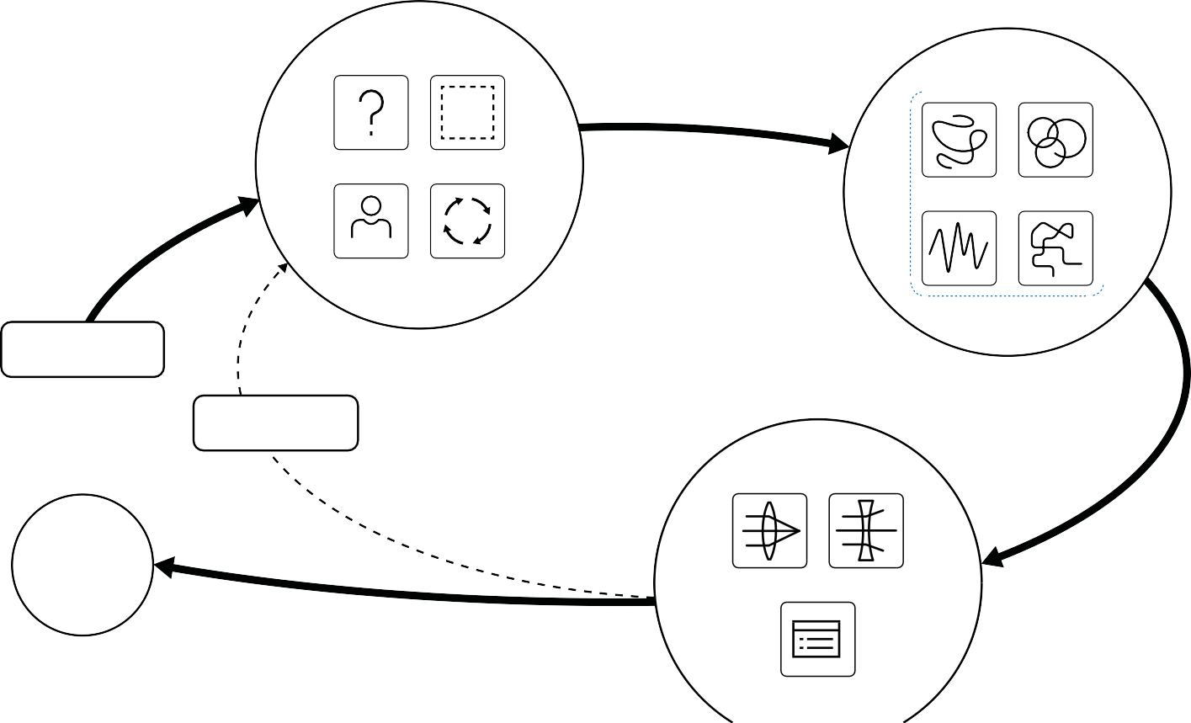
8
Human-Centered Design: Discovery Stage Field Guide
Introduction / Research Cycle
9
Step 1: Project Brief
The project brief is the initial ask, expressed interest, or situation to study. This can come from leadership, one of your partners, or from your own experience or inquiry.
Read more about Project Briefs on pages 10-11.
Step 4: Plan your research logistics
With your participants lined up, plan out the rest of the research logistics. Reserve a space, gather the tools, draft questions, and establish roles for the team. Read more about planning on pages 10-11 and 14-15.
Discovery Cycle
Step 2: Create a frame of inquiry
A frame of inquiry, or the “How Might We” question, identifies and frames the issue or the situation you are exploring. Use the “How Might We...” prompt to frame your area of inquiry. Read more about framing and HMW questions on pages 10-11.
Step 5: Do the research
As the participants move through your frame of inquiry in their own way, remember that their perceptions and approaches are valid reflections of their reality. That is what you want to understand. Read more about doing the research on pages 16-19.
BEFORE
DURING
Step 3: Recruit research participants
Work within your network (both inside and outside of your agency) to find participants who meet your criteria. Look closely for participants whose life circumstances and experiences align with your frame of inquiry. Read more about recruiting on pages 10-11.
1 . BRIEF
2 . FRAME
PARTICIPANTS
3 . RECRUIT
4 . PL AN
Step 6: Synthesis
Synthesis happens after your team has finished the interviews. Now, all members of your team come together and collectively review and analyze the information you’ve gathered. Now is the time to step back, take stock, and tease out common themes and patterns.
Read more about synthesis on pages 20-21.
START
Step 9: Reframe (if needed)
Often, after your first round of research and synthesis, you realize how much you didn’t know about what you didn’t know.
Step 7: Opportunities
Insights will emerge during synthesis. The best and most relevant ideas, quotes, and observations, will rise to the top. These can become fields of opportunity to explore.
Read more about Insights on pages 22-25.
REFRAME
Though it may not feel like progress, it is. Sometimes, at this stage, you also decide to adjust your “How might we…” question to one that more accurately captures your findings in this initial phase of research. You may also decide to engage in additional rounds of research.
AF TER
DESIGN PHASE
SYNTHESIS
OPPORTUNITIES
Step 8: Present
Now is the time to communicate your findings to stakeholders and leadership. Know your audience and tailor your presentation accordingly. Read more about presenting on pages 26-27.
Once your team has completed the research, synthesized the results, presented it, and have support to move forward, then the next step in the Human-Centered Design process is Design.
PRESENT

